Slide 1
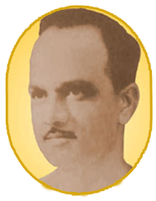

ABMSP’s Anantrao Pawar College Of Engineering & Research, Pune -09
A
Seminar on
PLASMA DONATION
Presented by
Swojas Bhalunkar
Siddhi Ekatpure
Swapnil Dadamode

Slide 2
Introduction
Plasma therapy is a treatment where the plasma from a recovered patient is injected in the body of an infected patient.
Plasma donation is an web application focused to keep an record of plasma.
It allows users to enter personal details of donor which get saved in an database.
Users can then search for plasma for specific blood group.

Slide 3
Overview
Motivation
Aim and objectives
Problem statement
Literature survey
Proposed system
Advantages
Disadvantages
Applications
Screenshots
Conclusion
Reference

Slide 4
Aim and Objective
To create an organized system to keep track of details of plasma donation.
This project aims for an systematic record database for the plasma donation.

Slide 5
Motivation
According studies, creating a vaccine for treatment of corona virus will take a long period of time. Plasma therapy was proposed by doctor as some experiments showed positive response.
Plasma donation became one of the problem as it was risky for both donor and receiver.
This motivates an idea to create an organized system for keep track of details of these plasma donation.

Slide 6
Problem statement
Design a user friendly system for recording details of plasma donation and also accessing them with ease.

Slide 7
Screenshots

Slide 8
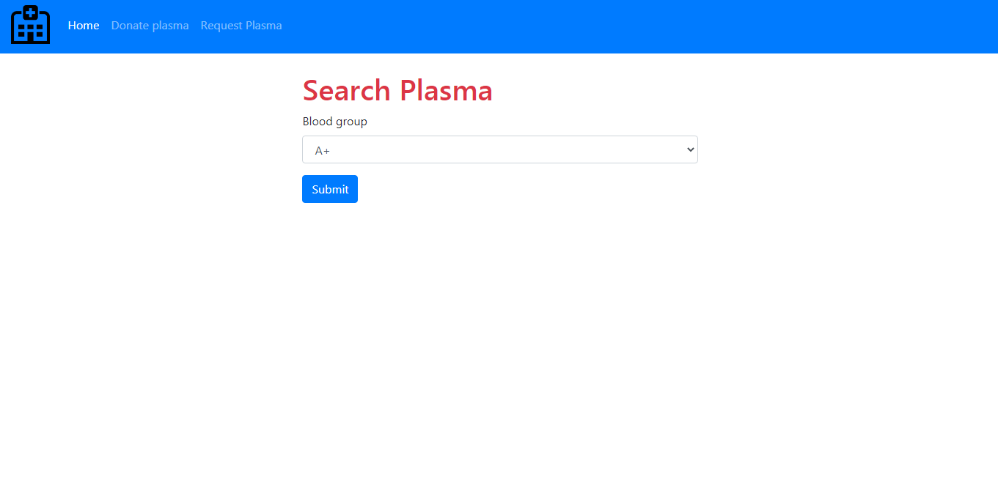
Screenshots

Slide 9
Literature Survey
SR no. | Reference Name | Work description | Problems found | Publication year
1 | Food and Drug Administration (FDA) | On Aug. 23, the Food and Drug Administration (FDA) issued an emergency use authorization (EUA) for convalescent plasma therapy to treat COVID-19. | > Doctors were not able to find donors for plasma therapy. | 2020
2 | Plasma Therapy | It has been observed that the antibodies present in the recovered patient’s blood neutralise the virus present in the COVID patient’s body. | >There was huge gap between no. of donors and receiver. | 2020

Slide 10
Advantages
Simple to use and understand.
Anyone can quickly make an entry in records as login is not required to update it.
Anyone can quickly check plasma for their blood group

Slide 11
Disadvantages
Modification and Deletion in records is not available.
There is no admin access in this application.

Slide 12
Applications
To keep an record of DONORS and RECEIVER.
Can be used in hospitals as well as government purpose.

Slide 13
Conclusion
Theoretically as per the COVID-19 pandemic, Plasma donation shall become more common and hence a system will be required to maintain the records for donor and receiver.
This system is pretty simple to understand and can be used to connect donor to receiver.

Slide 14
Reference
https://www.donatingplasma.org/
https://en.wikipedia.org/wiki/Treatment_and_management_of_COVID-19
https://www.Google.com
https://www.redcrossblood.org/

Slide 15

ANY QUESTIONS ?

